Slide 1
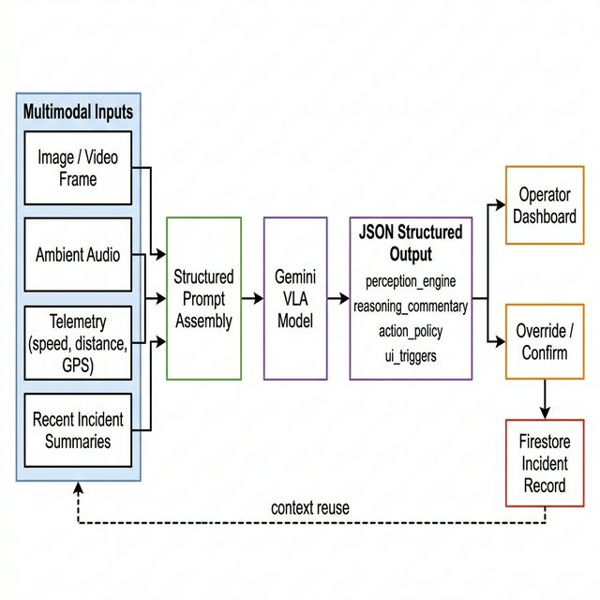
Masters Project Presentation
AGV Fleet VLA Intelligence
Multimodal Vision-Language-Action Decision Support for False-Positive Safety Stops in Autonomous Guided Vehicles
Vikas Rathore, Neha Anil Khot
Information Technology
Frankfurt University of Applied Sciences
Autonomous Intelligent Systems
Project guidance: Prof. Peter Nauth
Human-in-the-loop advisory system for operator review of AGV stop events. Prototype evidence, not autonomous actuation.
AGV Fleet VLA Intelligence
1/13

Slide 2
Problem and Motivation
PROBLEM
• False-positive AGV stops reduce throughput and increase operator workload.
• Range sensors can detect distance, but not whether the obstacle is harmless or dangerous.
• Lightweight foil, wrapping film, paper, and soft barriers can trigger the same stop logic as real hazards.
• Operators need faster context to distinguish nuisance stops from genuine risk without removing human authority.
Benign nuisance obstacles
High-risk obstacles
• Loose paper or wrapping material
• Reflective foil or soft plastic sheet
• Visually large but low-mass clutter
• Dropped pallet or heavy cargo
• Human worker or moving object
• Solid equipment blocking the AGV path
Why this matters operationally
A warehouse operator must decide quickly whether the AGV is blocked by harmless material or by a genuine collision risk. The presentation therefore positions the project as decision support for remote assistance, not as autonomous control.
The presentation focuses on a narrow warehouse stop-resolution problem: improving operator review, not replacing the vehicle safety controller.
AGV Fleet VLA Intelligence
2/13

Slide 3
Objective, Scope, and Contribution
SCOPE
Objective
Build a multimodal decision-support dashboard that helps an operator review AGV stop events using media, telemetry, and recent incident history.
In Scope
Out of Scope
• Operator-facing advisory dashboard
• Schema-constrained multimodal reasoning
• Incident persistence and traceability
• Prototype-level evaluation and audit tooling
• Autonomous actuation or motion control
• Live fleet integration or teleoperation
• Industrial deployment readiness claims
• Large-scale validated benchmark claims
Implemented multimodal advisory prototype
Structured operator workflow and persistence layer
Conservative evaluation and CSV-backed audit framework
AGV Fleet VLA Intelligence
3/13

Slide 4
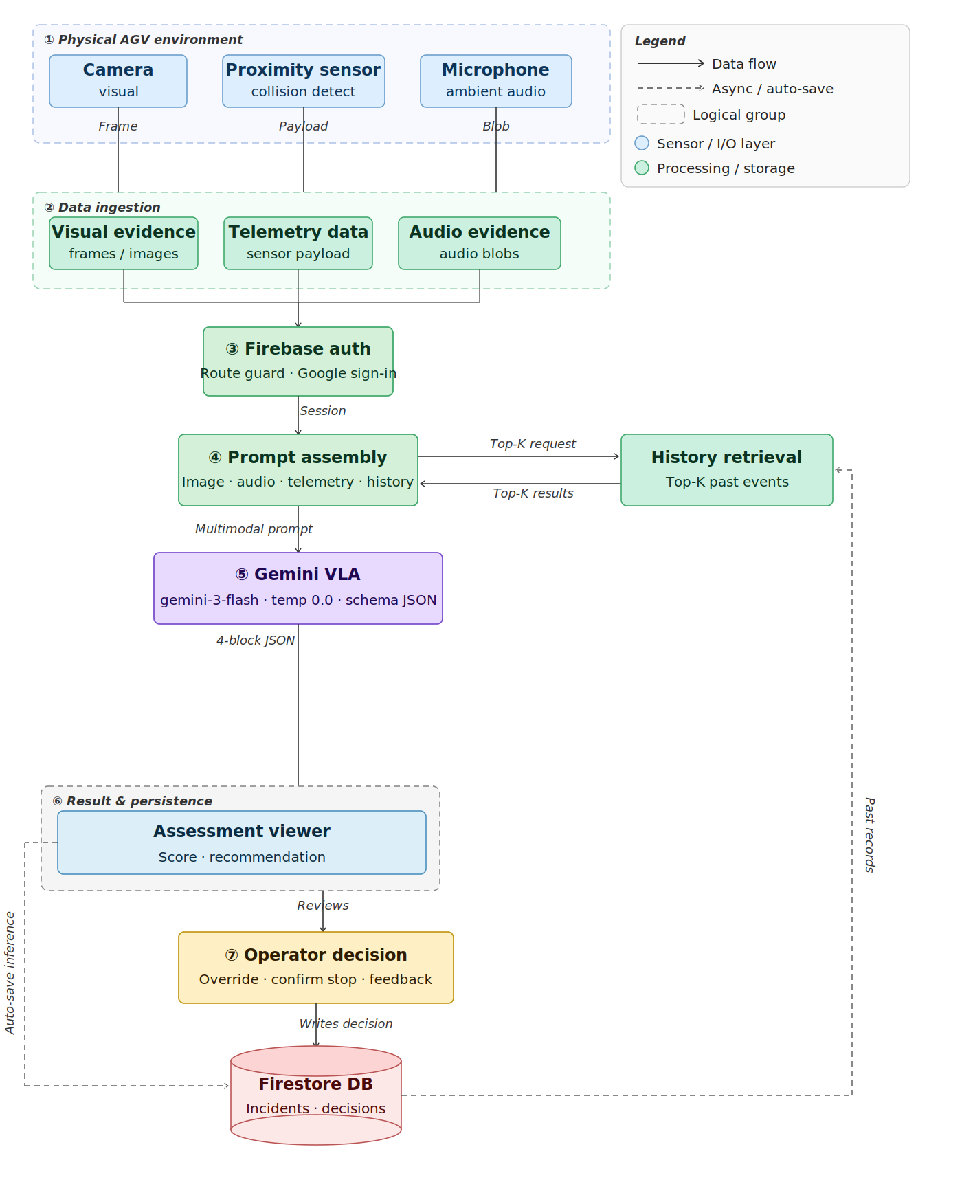
System Architecture
SYSTEM
• Inputs: image or video frame, optional audio, typed telemetry, and recent incident summaries.
• Processing: Gemini multimodal analysis with a constrained JSON response contract.
• Outputs: danger score, recommended action, commentary, and UI trigger state.
• Persistence: Firestore stores both model output and operator decision for later audit and reuse.
Functional diagram of the advisory pipeline from multimodal inputs to operator-facing recommendation and persistence.
AGV Fleet VLA Intelligence
4/13

Slide 5
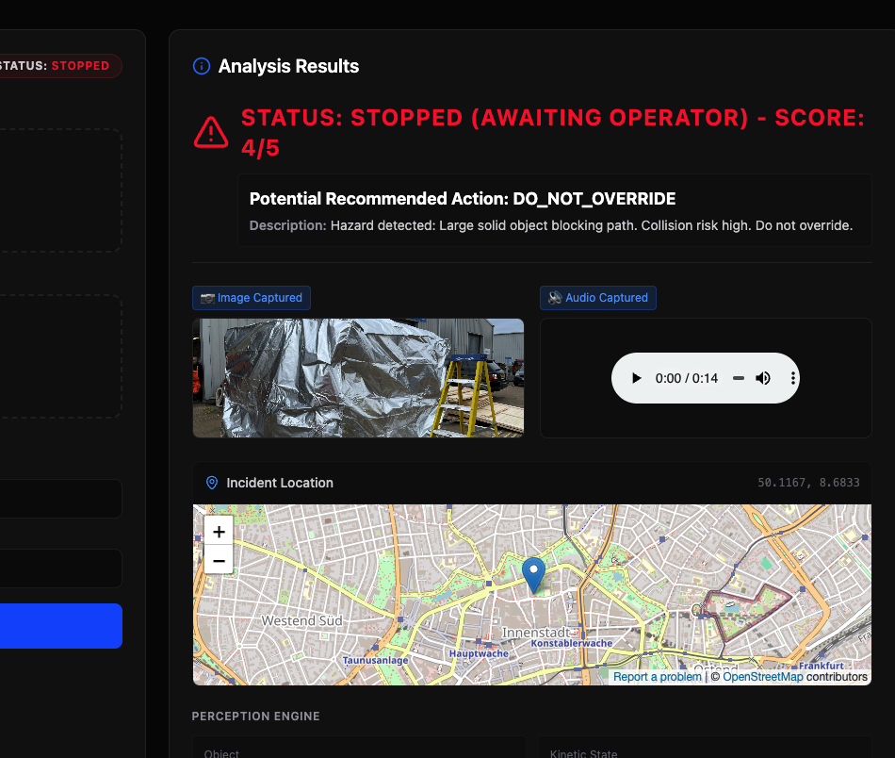
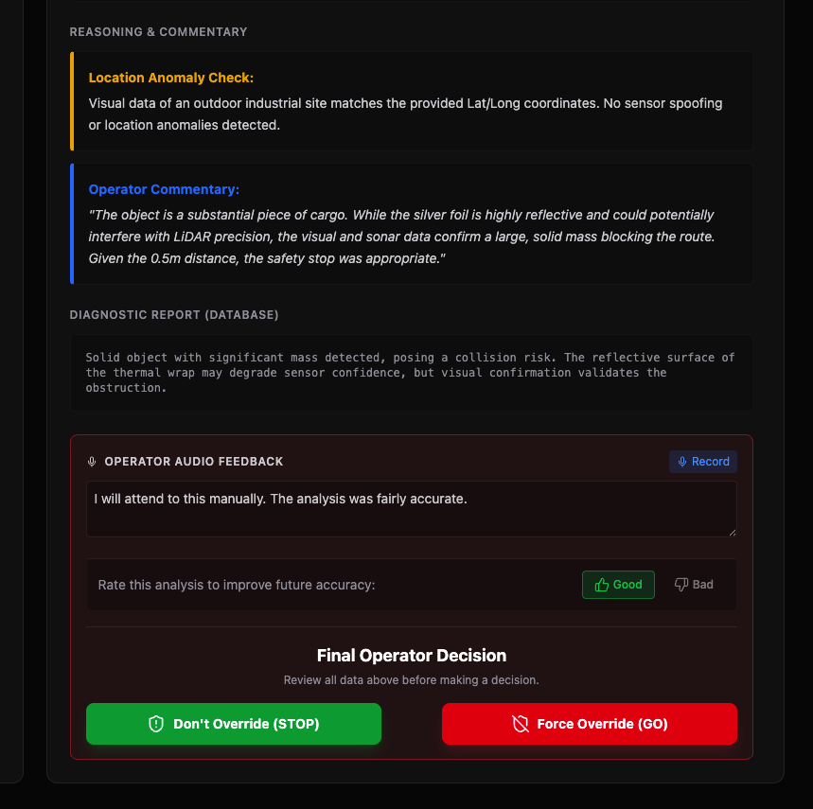
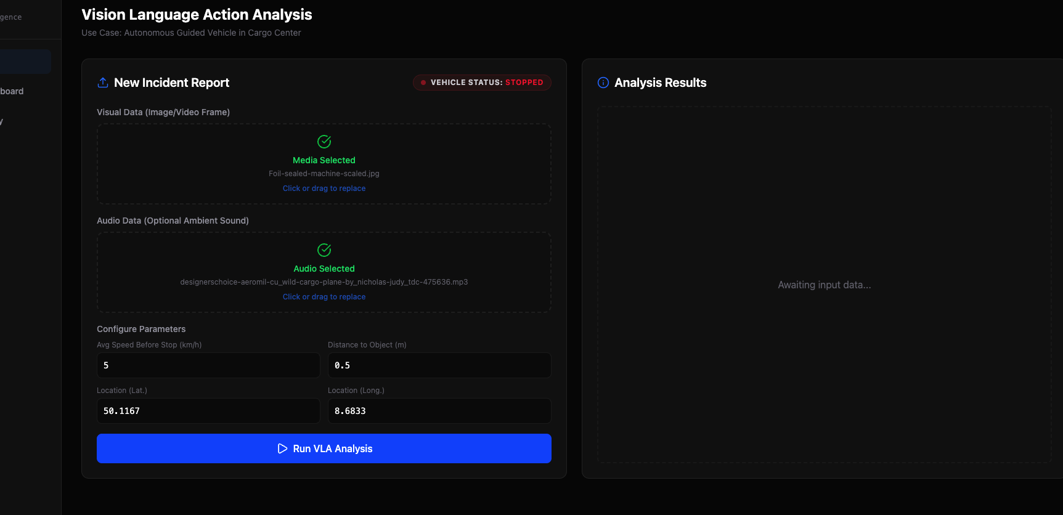
Prototype Workflow
WORKFLOW
1. Capture
2. Analyze
3. Decide
Operator provides incident media and typed telemetry in the prototype UI.
The advisory engine returns status, score, and recommended operator action.
The operator confirms the stop or forces an override; the final action is logged.
The implemented workflow remains human-in-the-loop at the final decision point.
AGV Fleet VLA Intelligence
5/13

Slide 6
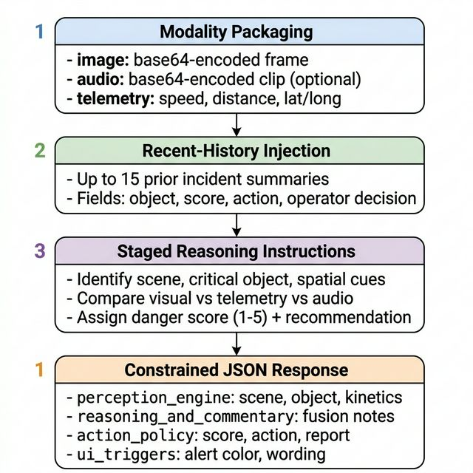
Model Contract and Decision Taxonomy
REASONING
Model configuration
• Main advisory model: gemini-3-flash-preview
• Deterministic decoding: temperature = 0.0
• Response format: application/json
• Prompt includes multimodal evidence and recent incident context
perception_engine
reasoning_and_commentary
action_policy
ui_triggers
Danger-score mapping
Scores 1-2: Safe to Override
Scores 3-5: Keep Stop / Do Not Override
AGV Fleet VLA Intelligence
6/13

Slide 7
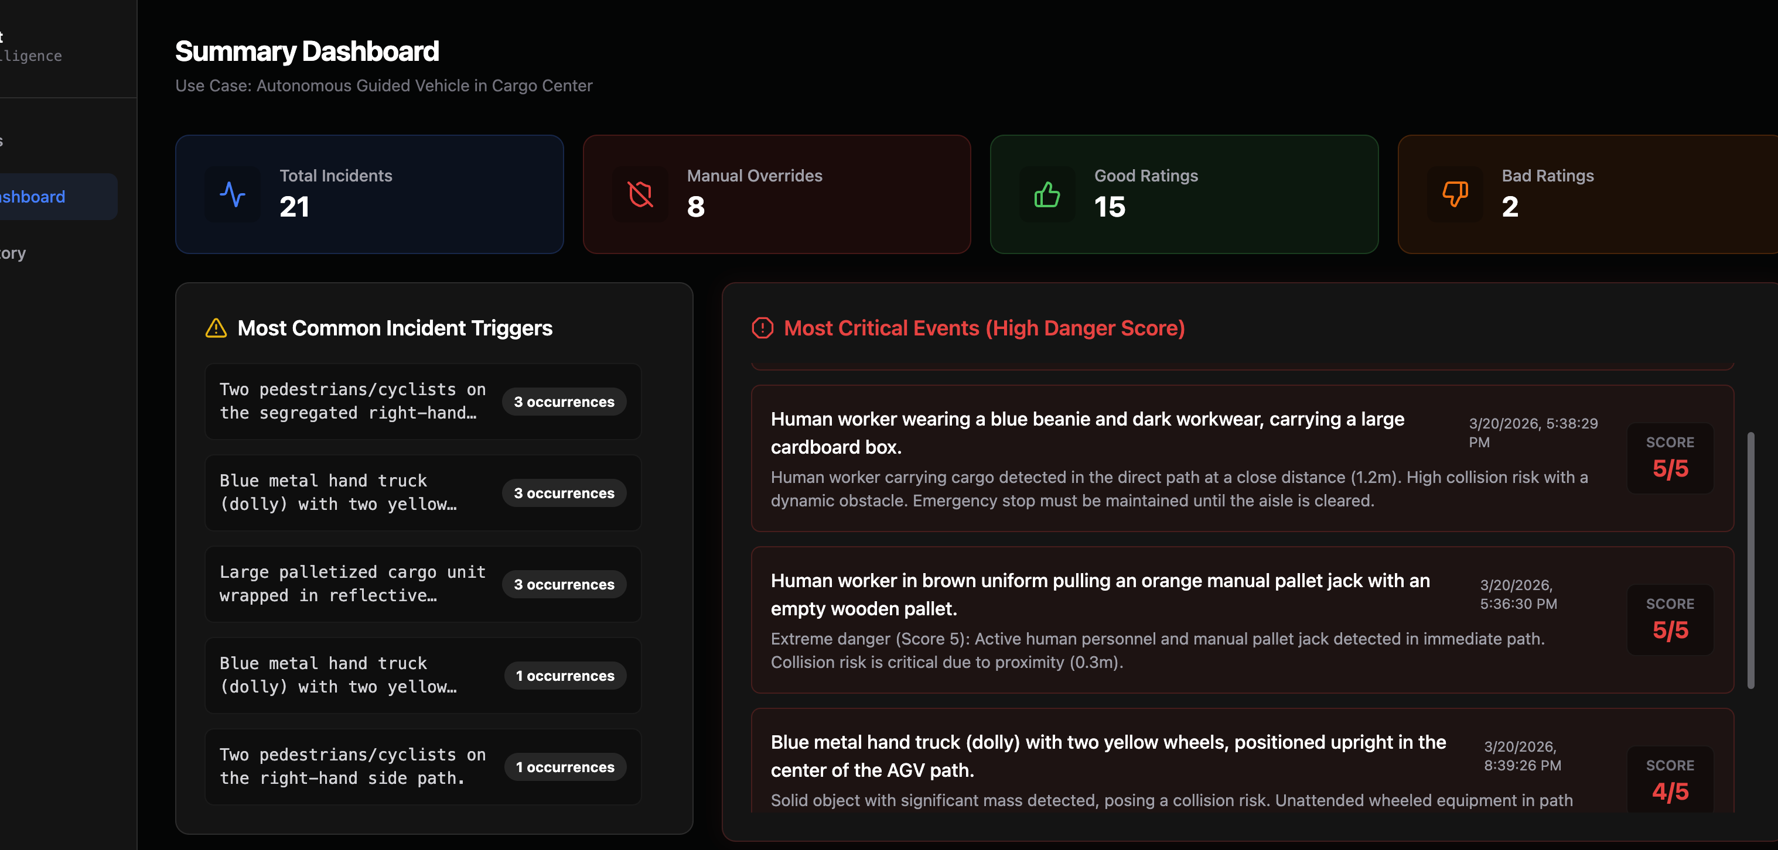
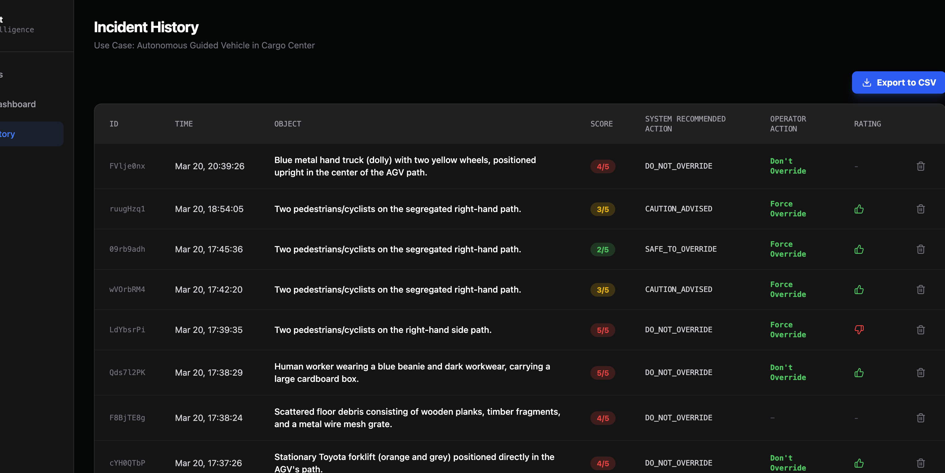
Persistence, Dashboard, and Traceability
TRACEABILITY
• Firestore stores incident context, model output, operator action, ratings, and notes.
• Dashboard views aggregate total incidents, critical events, and low-score overrides.
• Incident history supports CSV export and later audit of system recommendations versus operator actions.
• History snapshots and source IDs are stored to make future consistency analysis traceable.
Traceability value
Persisted history snapshots and source IDs make future score-drift analysis auditable instead of anecdotal.
AGV Fleet VLA Intelligence
7/13

Slide 8
Evaluation Design
EVALUATION
Pilot benchmark
Operational audit
• 4 conservative text-surrogate scenarios
• 1 clearly safe, 1 borderline, 2 clearly unsafe
• 1 history-enabled case
• 0 repeated scenario pairs
• 20 exported dashboard incidents
• 3 repeated object groups and 9 repeated rows
• 1 repeated group with score variance
• 2 telemetry anomaly rows
Binary decision boundary review
Danger-score drift on repeated cases
Operator-action traceability
Data-quality anomaly detection
The current evidence is prototype-level and descriptive. It is not an industrial validation benchmark.
AGV Fleet VLA Intelligence
8/13

Slide 9
Operational Audit Results
RESULTS
Exported incidents
Repeated groups
Repeated rows
Variance groups
Telemetry anomalies
20
3
9
1
2
Interpretation
• The repeated-case evidence is small but useful for descriptive consistency checks.
• Only one repeated object cluster showed score variance in the export.
• Two repeated object groups remained stable at score 4 across all three occurrences.
Source: incident_history_audit.json generated from the exported dashboard CSV.
AGV Fleet VLA Intelligence
9/13

Slide 10
Repeated-Case Findings
FINDINGS
Alias
Score
Operator
Interpretation
Stable groups
PED-A
3/5
Force Override
Segregated lane; clean telemetry
• Blue hand truck group: 4, 4, 4 and operator kept stop.
• Reflective silver cargo group: 4, 4, 4 across all three rows.
PED-B
2/5
Force Override
Segregated lane; malformed lat/long
PED-C
3/5
Force Override
Segregated lane; clean telemetry
Conclusion: the observed 2 versus 3 split is localized and input-sensitive, not evidence of broad nondeterminism.
AGV Fleet VLA Intelligence
10/13

Slide 11
Challenges, Limitations, and Mitigations
LIMITS
Challenge
Effect on evidence
Mitigation in this project
Free-tier quota and API project limits
Model-side reruns could not be scaled credibly
Reported the offline audit truthfully and kept a quota-safe probe harness ready
Small pilot benchmark
No strong statistical performance claim is justified
Framed results as prototype evidence and audit evidence only
Manual telemetry entry in the prototype
Operator-entered inputs can introduce noise or malformed fields
Included telemetry anomalies explicitly in the operational audit
Text-surrogate benchmark inputs
Benchmark does not fully match raw-media production conditions
Separated the pilot benchmark from the operational dashboard audit
No formal HCI field study
Operator trust and speed effects remain unvalidated
Positioned HCI evaluation as future work
The advisory-only system boundary is intentional and remains appropriate given current VLM spatial-reasoning limits.
AGV Fleet VLA Intelligence
11/13

Slide 12
Conclusion and Future Work
OUTLOOK
Key takeaways
Future work
• A working multimodal AGV advisory prototype was implemented.
• The strongest contribution is the operator workflow, persistence layer, and traceability design.
• The present evidence is limited but honest, reproducible, and appropriate for a masters-level prototype.
Expand the benchmark from 4 scenarios to a wider and more varied case set.
Automate live telemetry ingestion through an API or streaming interface.
Move benchmark coverage from text surrogates to raw media inputs.
Run an HCI study on operator trust, explanation quality, and review speed.
Best positioning: a credible academic prototype with a clear path to stronger evaluation.
AGV Fleet VLA Intelligence
12/13

Slide 13
Appendix: Selected References
APPENDIX
Selected literature
• Ahn et al. (2022) - SayCan: grounded language for robotics.
• Brohan et al. (2023) - RT-2: vision-language-action modeling for robots.
• Tian et al. (2024) - DriveVLM: staged reasoning for autonomous driving.
• Parr et al. (2024) - remote monitoring, assistance, management, and driving.
• Guo et al. (2024) - SURDS: spatial reasoning limitations in multimodal models.
The full bibliography and methodological detail are documented in the project report.
AGV Fleet VLA Intelligence
13/13

